Slide 1

Classification of text documents; a case study of emails
28/04/2017
Second Seminar Advanced Analytics
Advanced Analytics Seminars

Slide 2
Agenda
Applications
What is text classification?
Classification Methods
- Manual: Hand-code rules.
- Automatic: Supervised Machine Learning.
How does text classification work?
Text classification: Case study of emails.
Demo/ Experiment in Python

Slide 3


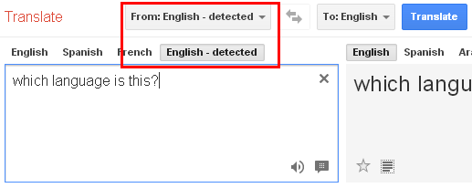
Applications
Text classification
News articles classification
Assigning subject categories, topics or genres.
Automatic email filtering
Spam detection
Webpage classification
Language Identification
…

Slide 4




Text Classification
Definition
Text classification: Given a set of categories (subjects, topics) and a collection of text documents, the process of finding the correct topic(s) for each document.
Input:
A document d
A fixed set of classes C = {c₁, c₂,..., c_{n}}
Output: a predicted class c in C
Sales
Business
Insurance
Premium
…
Claims
Classification system
Input
Output
Claims
Complaints
….
Sales
Input: Labeled document examples
Classes/labels/ categories

Slide 5
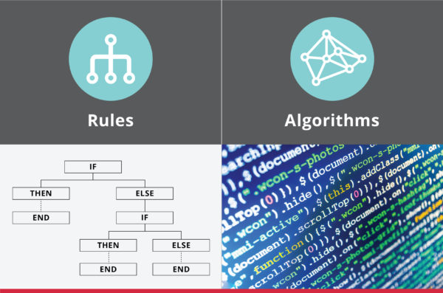
Classification Methods
Manual: Typically Hand – code rules based.
Rules based on combinations of words or other features
Ex: Spam: black-list-address or “dollar” then spam.
Building and maintaining these rules is expensive.
Does not scale up.
Automatic: Typically using Supervised Machine Learning algorithms.
Decision tree (learn rules)
Neural Networks (learn non-linear classifier)
Support Vector Machines (SVM)
Naïve Bayes classifier
Logistic Regression
…

Slide 6
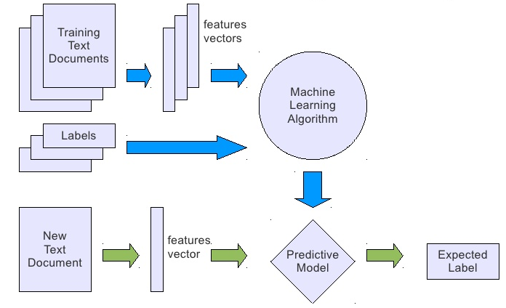



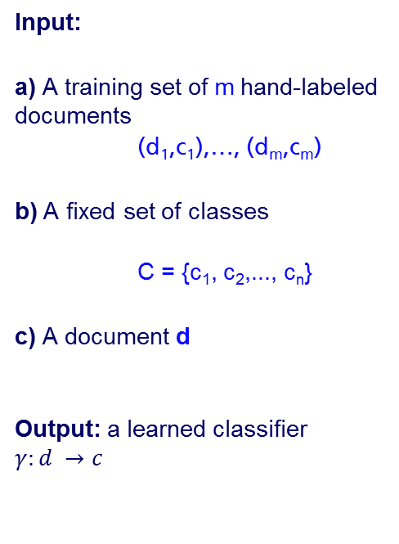
Classification Methods
Supervised Machine Learning summary
Input
Input:
a) A training set of m hand-labeled documents
(d₁,c₁),…, (d_{m},c_{m})
b) A fixed set of classes
C = {c₁, c₂,..., c_{n}}
c) A document d
Output: a learned classifier $γ:d →c$
a)
b)
Output
c)

Slide 7
How does text classification work?
Classification process
Selection Training / Test Set
Classification Model
Validation
Classify New Doc
Data processing
E.g. Term Extraction, tokenize, Dimensionality Reduction, feature selection
Definition of the set of documents to model and to test
Creation of the classification model using the select classification algorithm
Validate the classification model
Classification of new / unknown text documents

Slide 8
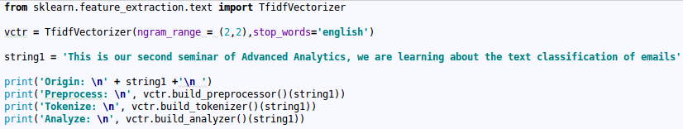
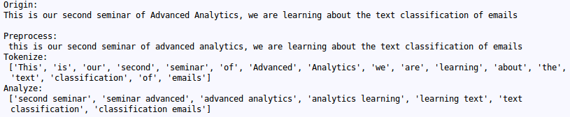
How does text classification work?
Data processing: small example
Dealing with the document: Demonstration of feature extraction of text
Result:

Slide 9
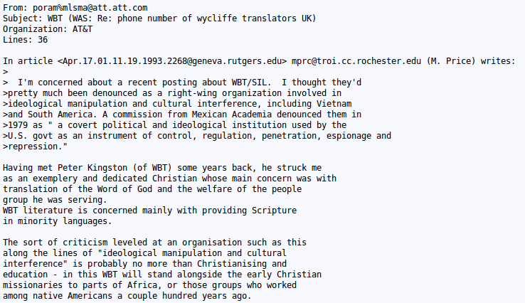
Case study of emails
Structured data
Text
Data Processing: Preprocessor, tokenizer, Analyzer (filters stop words)
Decrease the number of features.
Use the Training the model.
Get prediction

Slide 10


Demo in Python
Experiments

